Slide 1

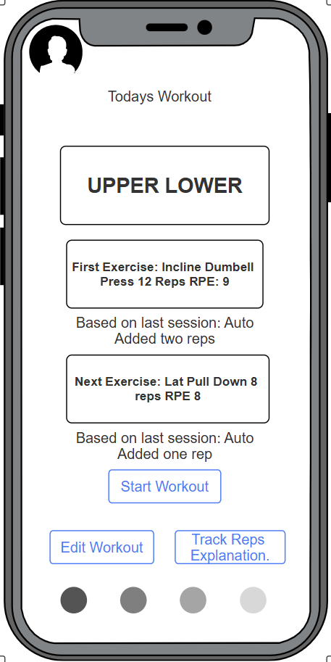
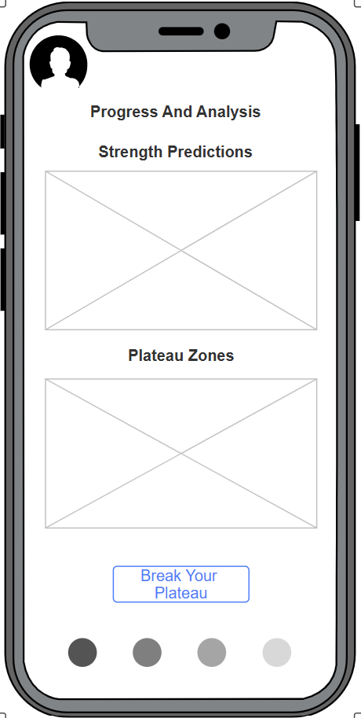
Kinetiq
Rajveer Khosa, Matthew Quezada,
Moises Gonzalez, and Oscar Rocha
Overview & Motivation
What We’re Building & Why it matters
We’re building a mobile app that suggests your next lift weight and even predicts when you’ll hit your next PR, all while clearly explaining why it recommends each load based on your recent sets. This matters because most lifters still guess what weight to use, which leads to stalled progress, missed lifts, and higher injury risk. Current logging apps only track what you did, and most training templates aren’t personalized or adaptive, leaving lifters without guidance. This app fills that gap with smart, individualized recommendations that actually make sense.
How it works
Compute e1RM (estimated one-rep max) from each set (uses weight, reps, RPE)
Track true strength with a Kalman estimate (with confidence)
Convert target e1RM → next load (plate-aware, capped jumps)
Scope for this course
iOS app (Swift/SwiftUI) + SQL backend.
Dashboard for Nutrition, Workouts, PR evaluation
How It Works & Benefits
Core Idea
Compute e1RM from each set (weight, reps, RIR).
Track true strength with a Kalman estimate (+ confidence).
Convert target e1RM → next load (plate-aware, capped jumps).
Why is This Better
Explainable: shows why a load is suggested.
Personalized: adapts per lift, per user.
Private & fast: on-device math; works offline.
Safer progress: caps prevent reckless jumps.
Key Outcomes
More sets in target RIR (1–3).
Fewer failed attempts.
PR ETA that improves as you train.
Build & Team
Tech
App: SwiftUI + Swift Charts (on-device calc: e1RM, EMA, Kalman).
Backend: Plain SQL (T-SQL/SQL Server) via small REST bridge.
Sync: JSON with URLSession; local cache; CSV export.
Privacy: On-device by default; opt-in sync.
Success Measures
% sets in target RIR.
PR ETA accuracy.
Fail rate ↓; user adherence ↑
Team Roles
Rajveer: iOS App/UI: SwiftUI screens, charts, offline cache, accessibility.
Matthew: ML/Algorithms: e1RM/EMA funcs, Kalman, load picker, PR ETA.
Moises: Backend/SQL: schema, prepared queries, REST endpoints, auth.
Oscar: QA & Data: synthetic data, test plans, telemetry, docs & poster.
College of Natural Sciences, Mathematics, and Engineering
Department of Computer and Electrical Engineering and Computer Science
Notes:
Logging apps (Hevy/Fitbod): good logs, weak/opaque load picks.
Programs (5/3/1, TM, Juggernaut): templates, not per-user, per-set.
Gap: per-user probabilistic strength tracking with transparent “why this weight” and PR ETA.

